Slide 1
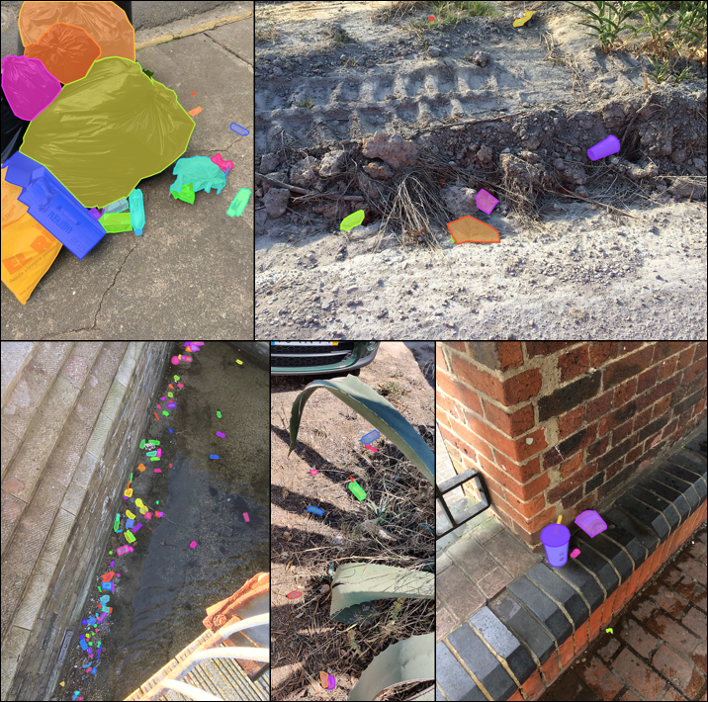
Senior Project Overview
CSC 190 Fall 2022 – Spring 2023

Slide 2
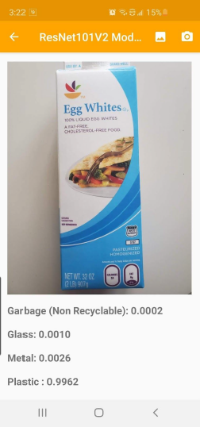
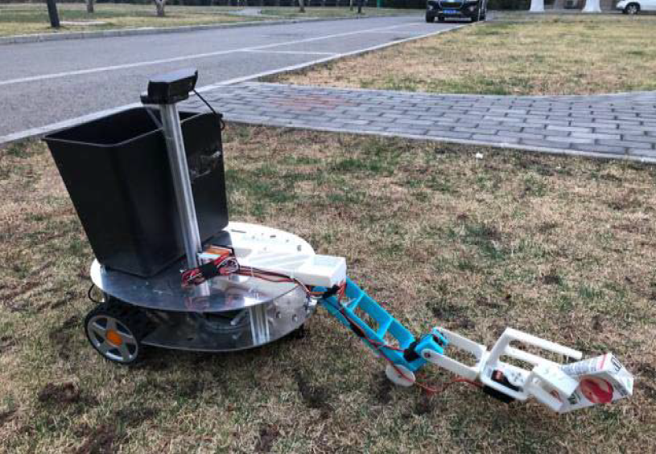
Early Trash Detection
An android app uses computer vision to classify trash into 6 material types on a blank background
A prototype trash cleanup robot designed to clean up trash in grassy areas showed promising results

Slide 3
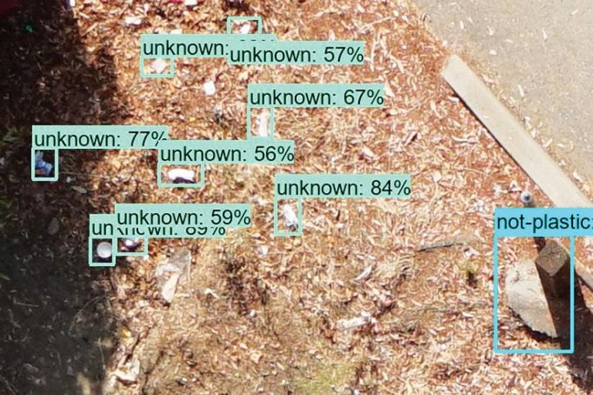
Searching for Trash using Drones
California and Bay Area coastal protection agencies are using TensorFlow trained on images from drones to search for trash source
“To help city planners find the best ways to filter their stormwater and stop contaminants such as trash and plastics from entering their protected wetlands and public waterways” Hale

Slide 4
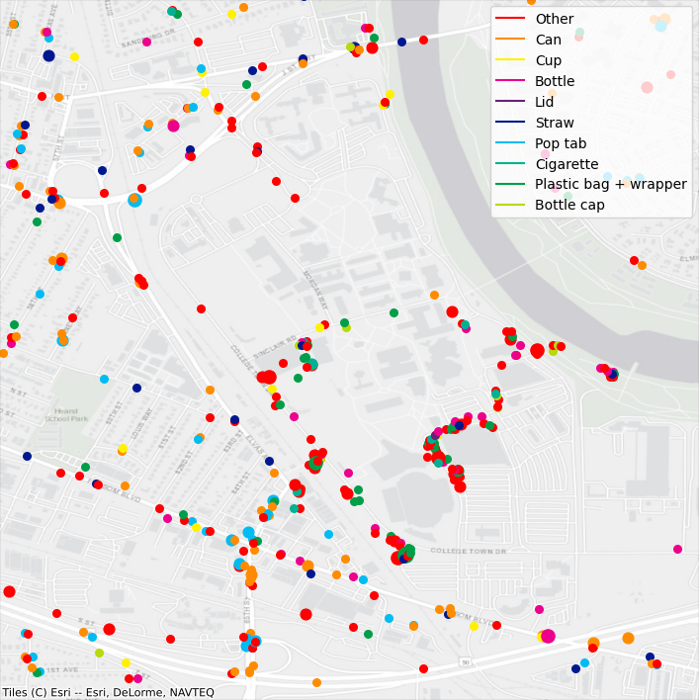
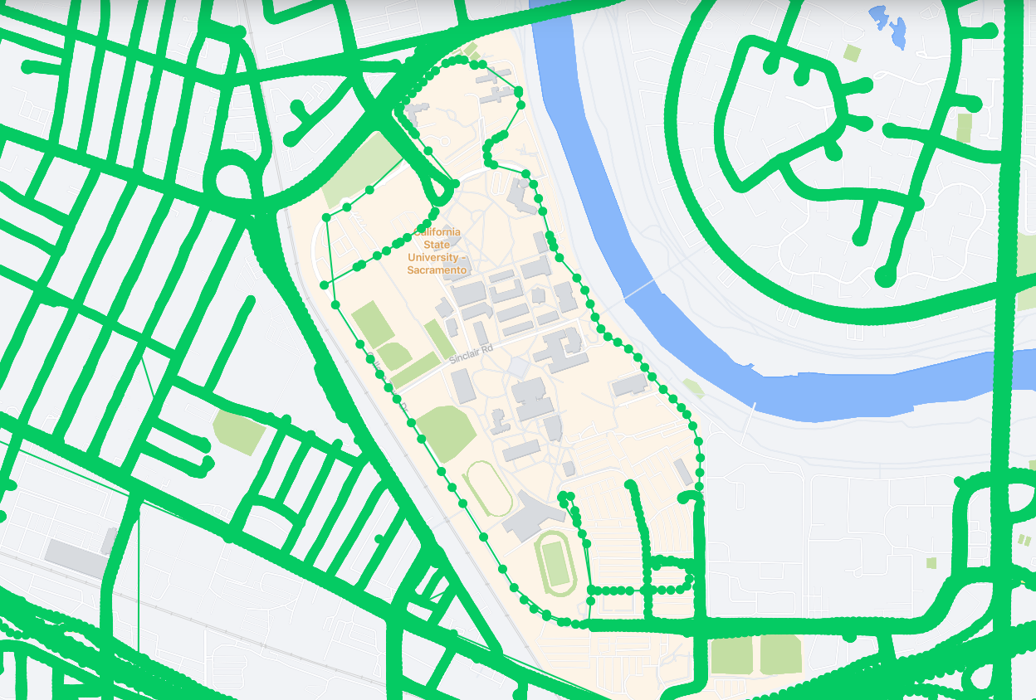
Litter Detection
Scans smartphone and Mapillary images to trash with Mask RCNN, creating a physical map of where trash is located
Mapillary image coverage
Litter detection map

Slide 5
Problems
No centralized trash dataset (TACO?)
1.5K images in TACO vs
35K in SEFI drone trash detection vs
330K images in the COCO dataset
Tmore localized information
Can it be accessed from the Sacramento waste wizard?
rash datasets need to be linked with outside sources to provide
Translate accuracy to real world improvements
Does a smart trash-can improve recycling rates?
How well does Edge AI perform for trash detection?

Slide 6
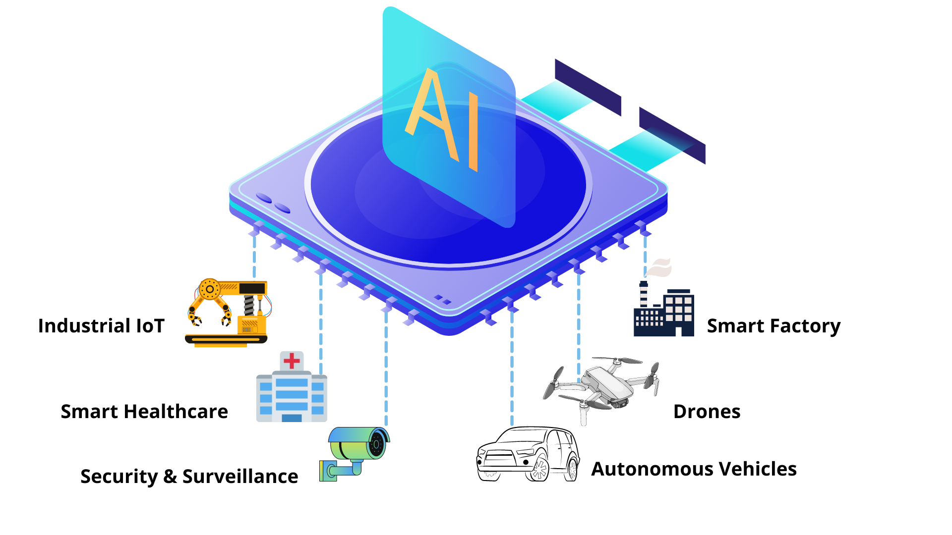
Tasks: Pick one or more
Machine learning for computer vision:
Improve the accuracy of the model to 95%+ by adding new images, and applying machine learning techniques
Collecting images & annotating, choosing model architecture, and training and validating the model
CSC 163 GPU Programming, 177 Data Analytics and Mining, 180 Intelligent Systems
Web scraping & API integration:
Web development/database scraping for querying the waste wizard
CSC 134 Database Management Systems, 177 Data Analytics and Mining, 196w Web Programming
Edge AI/hardware:
Hardware development to deploy small, AI oriented, cameras in trash cans or along water ways
CSC 139, 159, 163

Slide 7
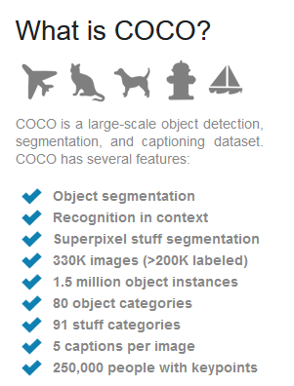
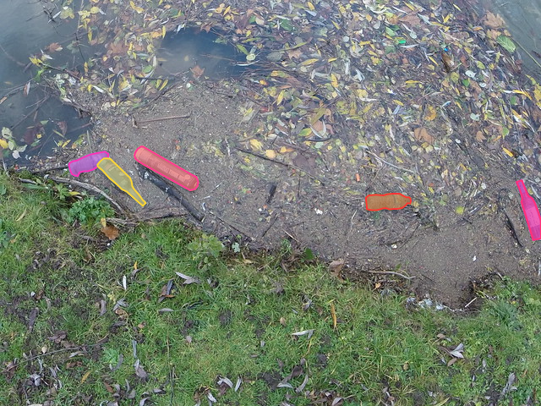
Dataset/Model Improvement
Collect and upload new images, using COCO as a standard to work towards
Train new models these images and compare against the pre-trained model for precision and recall

Slide 8
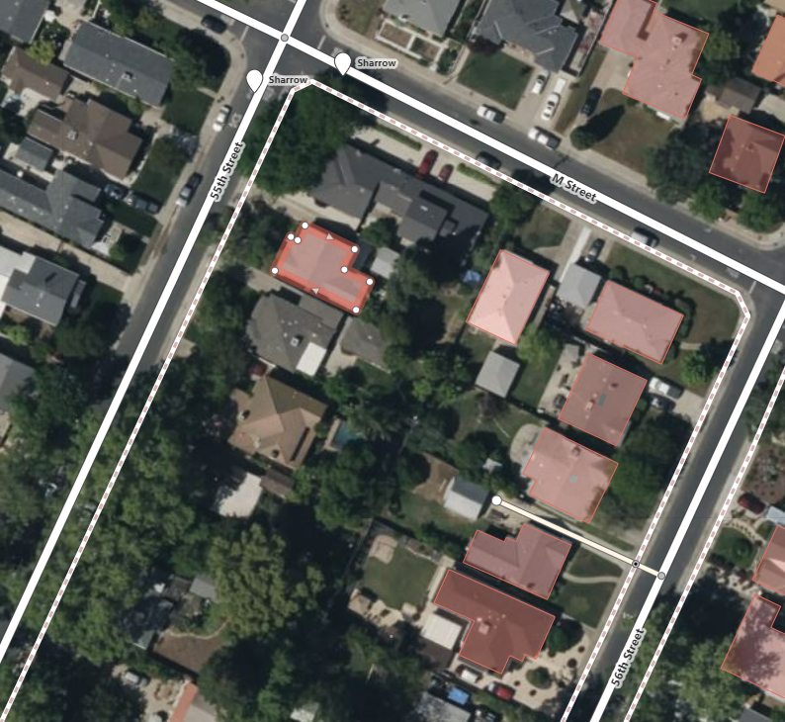
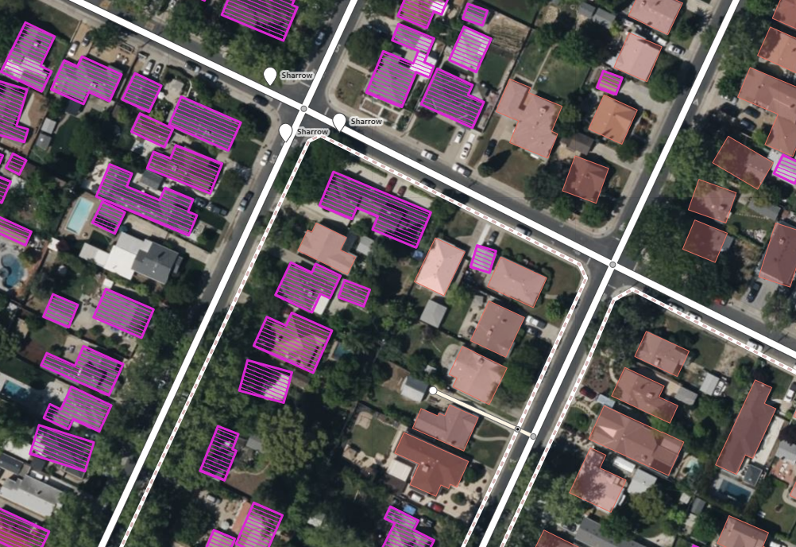
Automatic Annotations
OpenStreetMap has a similar manual annotation method
Can outline ~7 buildings per minute
Facebook releases RapID, a plugin that using Mask R-CNN to suggest building outlines
Improves annotation rate to ~20 buildings per minute

Slide 9
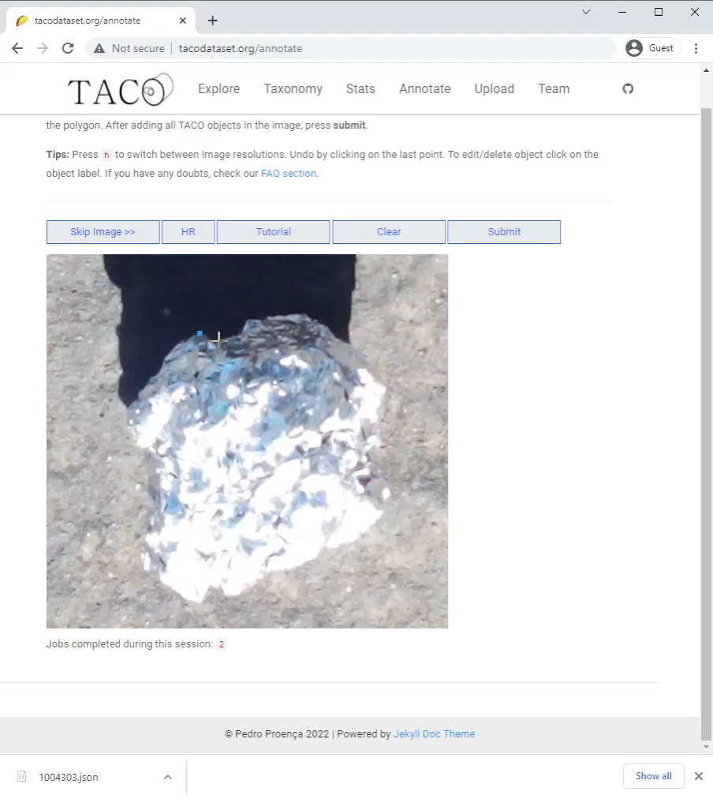
Annotations
Can we use Mask R-CNN to suggest a trash outline?
How much does this speed up annotations and how many do we need to do for this development to pay off?
How to we remove 8 photo upload limit to speed up photo uploads?
How many total annotations will we need for 95%...99% accuracy? 10,000…100,000?

Slide 10
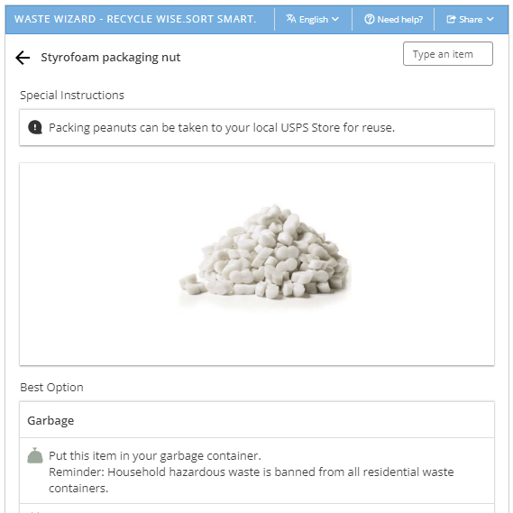
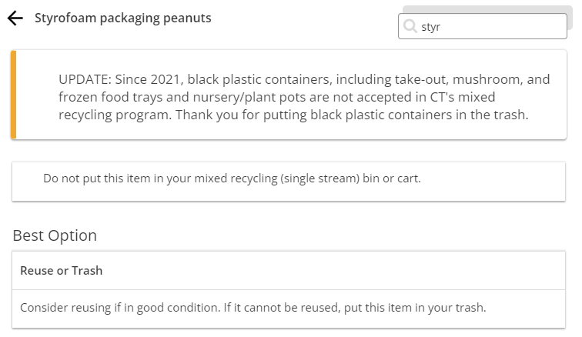
Waste Wizard
Recollect works with multiple agencies to provide location specific recycling information using the same underlying database
Sacramento Styrofoam peanut
Connecticut Styrofoam peanuts

Slide 11
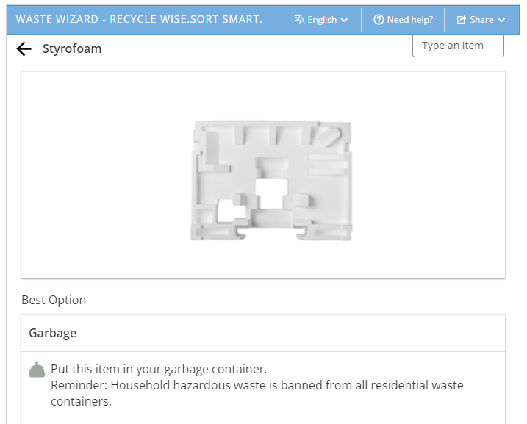
Waste Wizard
Use the predictions from Mask R-CNN to search the database: plastic bottle, Styrofoam, paper bag
The waste wizard shows which bin to put an item in using fuzzy search
We could work with Recollect and the City of Sacramento to use our detection algorithm as a search feature
Scrape the results and return: Garbage, recycling, green waste, not trash

Slide 12
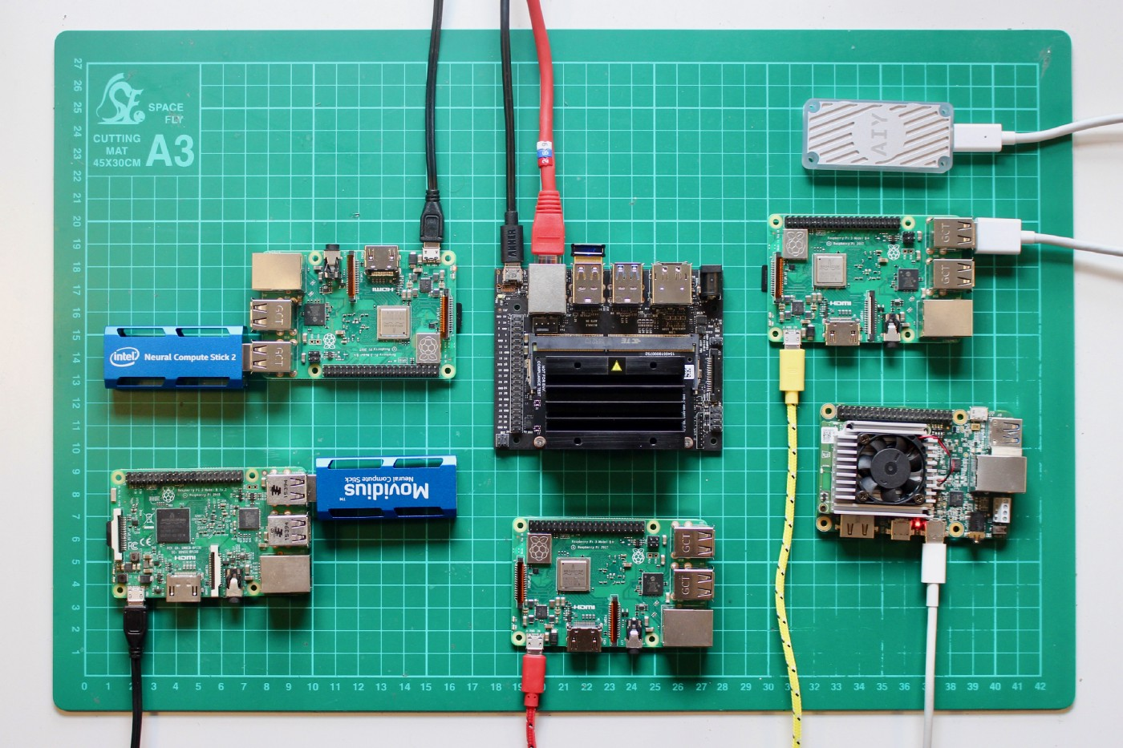
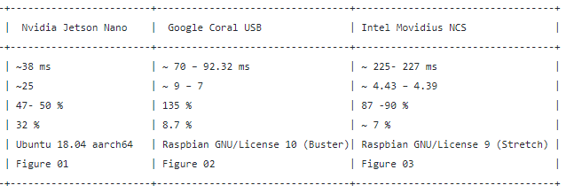
EDGE AI computing
Intel vs Google vs NVIDIA benchmark
The edge AI device we choose will impact what algorithm we can run!

Slide 13
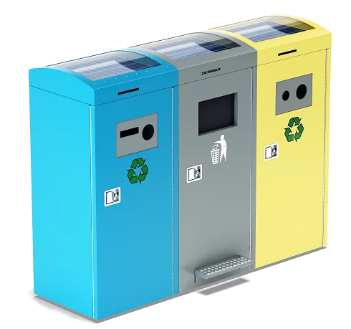
EDGE AI: Smart Can
Use a raspberry Pi, camera, LED lights, and TPU or GPU to signal to the user which bin to place the trash into
Take a photo and scan it
Return 1 of 4 categories
Turn on the LED associated with a bin

Slide 14
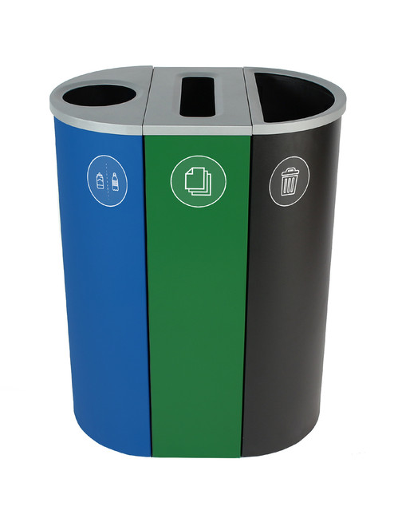
The Big Picture: Composting & Recycling
Does a self sorting trash can have higher accuracy rates than humans?
California has a “42% recycling/composting rate in 2020, up from 37% the year before. California’s goal for 2020 had been 75%, however.” resource-recycling.com

Slide 15
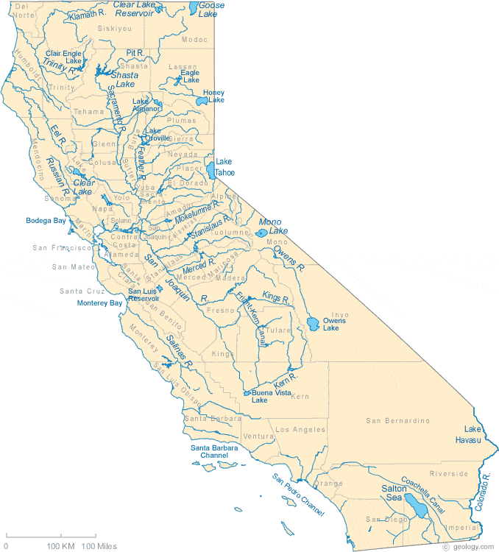
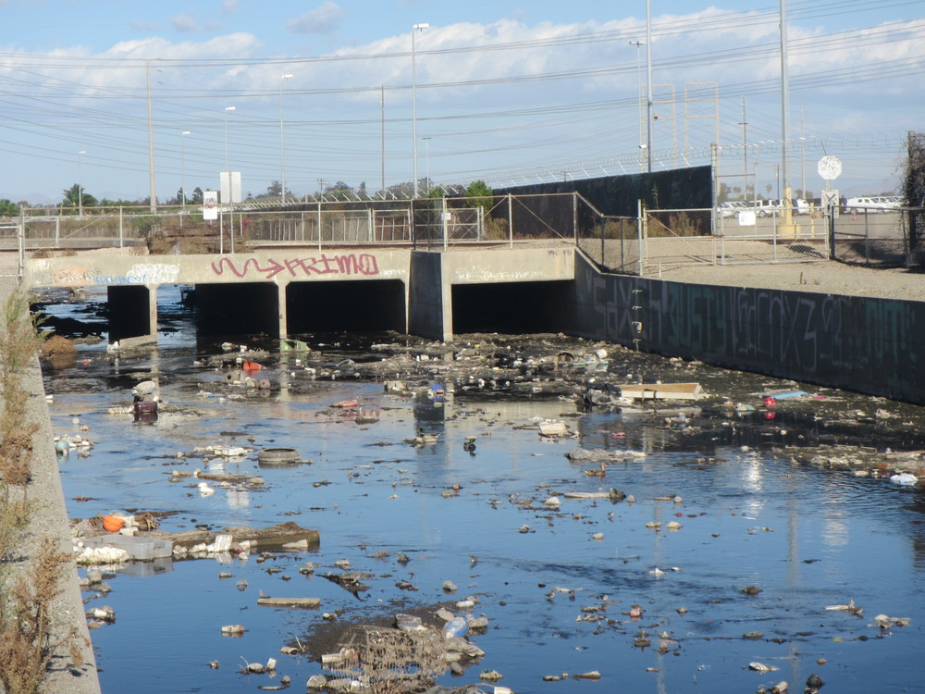
Measuring plastic in Waterways
How can the amount of trash entering and exiting the waterways be monitored?
Work with recollect, City of Sacramento, San Francisco Estuary Institute (SFEI)

Slide 16
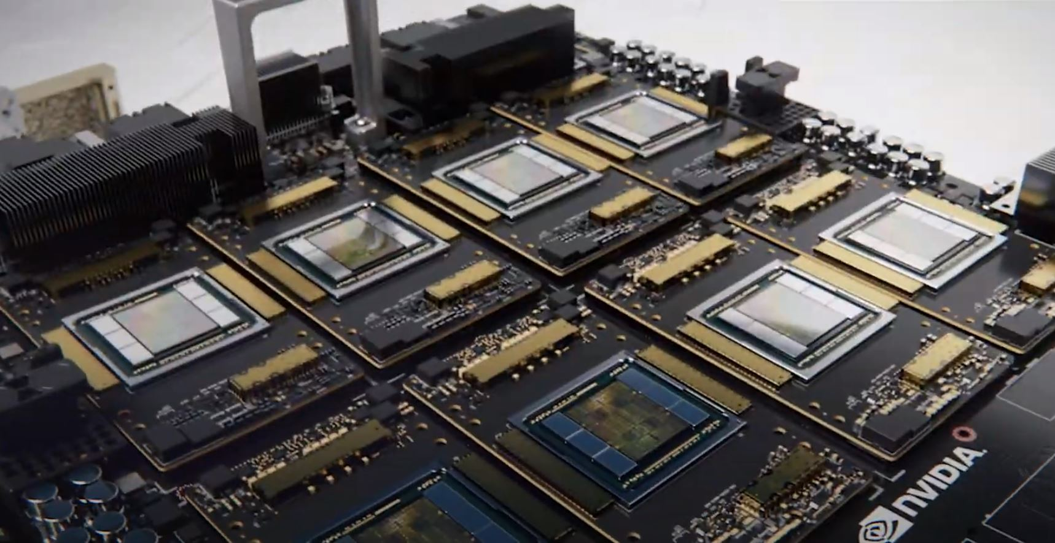
CLOUD AI: Website
Upload and image and get the result
Run inference and re-training in the cloud with GPUs
Forward results to the waste wizard
Make image API available to enable many Edge AI use cases

Slide 17
Tasks: Pick one or more
Machine learning for computer vision:
Improve the accuracy of the model to 95%+ by adding new images, and applying machine learning techniques
Collecting images & annotating, choosing model architecture, and training and validating the model
CSC 163 GPU Programming, 177 Data Analytics and Mining, 180 Intelligent Systems
Web scraping & API integration:
Web development/database scraping for querying the waste wizard
CSC 134 Database Management Systems, 177 Data Analytics and Mining, 196w Web Programming
Edge or Cloud AI hardware:
Hardware development to deploy small, AI oriented, cameras in trash cans or along water ways
CSC 139 OS Principles, 163 GPU Programming

Slide 18

Questions and concerns?

